Slide 1
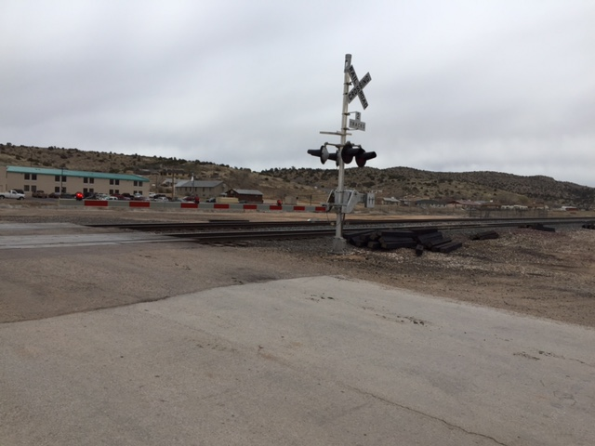
Peach Springs Underpass/Overpass
(Structural)
Presentation By:
Flag-Tech Engineering
Yuliang Wang, Yiyang Chen, Jonathan Melendez

Slide 2
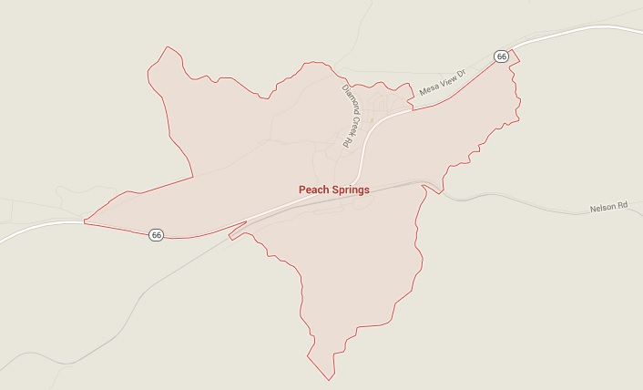

Project Understanding: Location of Interest
113 Miles West of Flagstaff, AZ
Part of the Hualapai Reservation

Slide 3
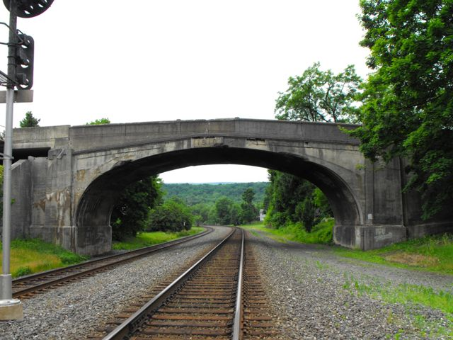
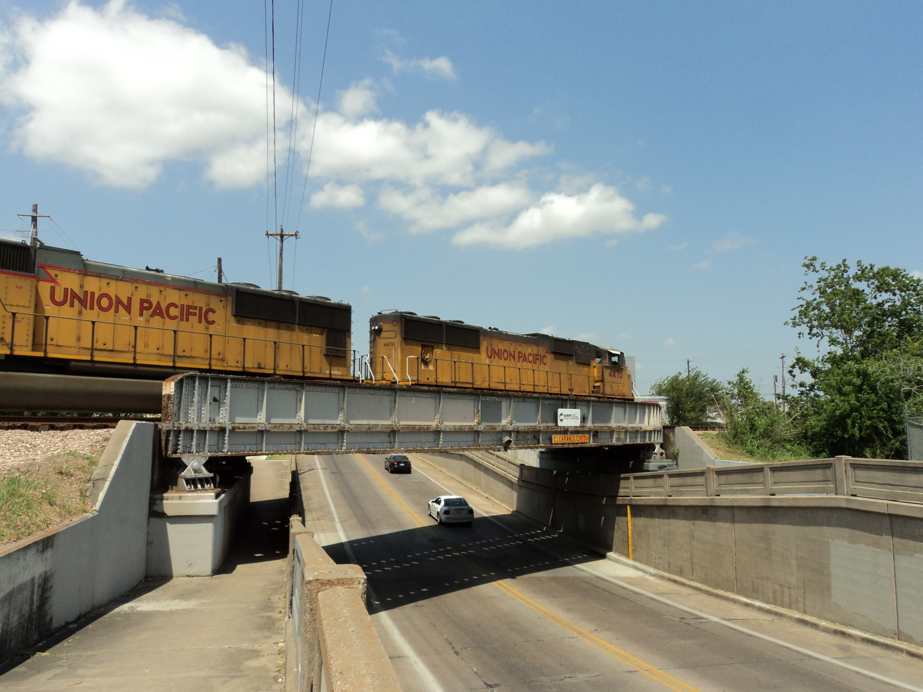
Project Understanding: Design
Two Teams (Structural & Grade Separation)
3

Slide 4

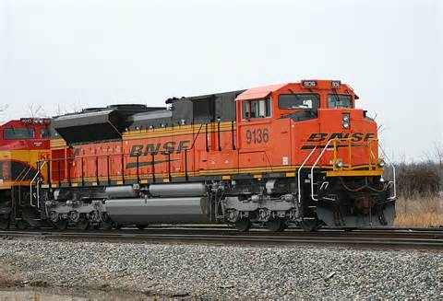
Project Understanding: Stakeholders
BNSF
Mojave County
Hualapai Reservation

Slide 5
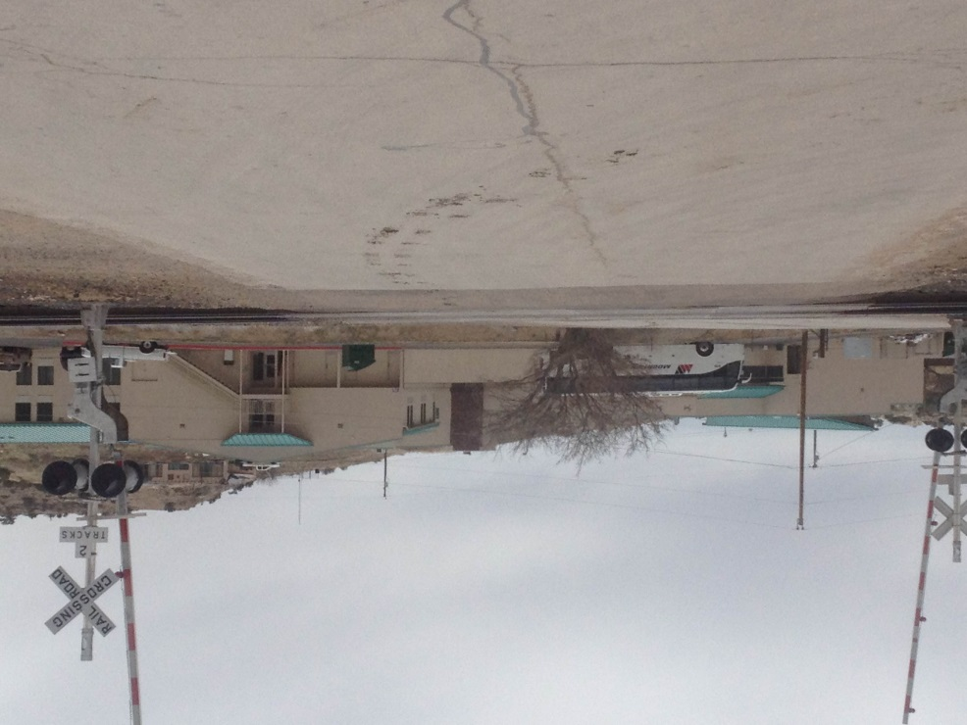
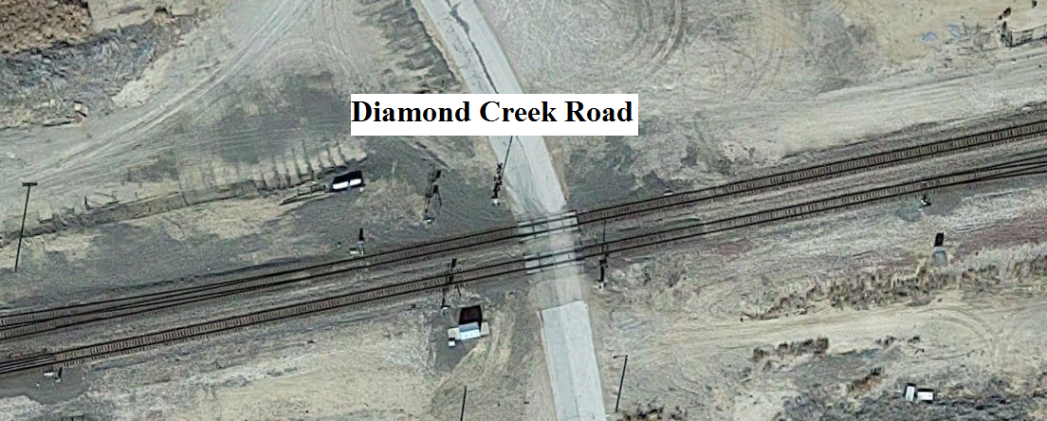

Project Understanding: Current Crossing
At Grade Crossing

Slide 6
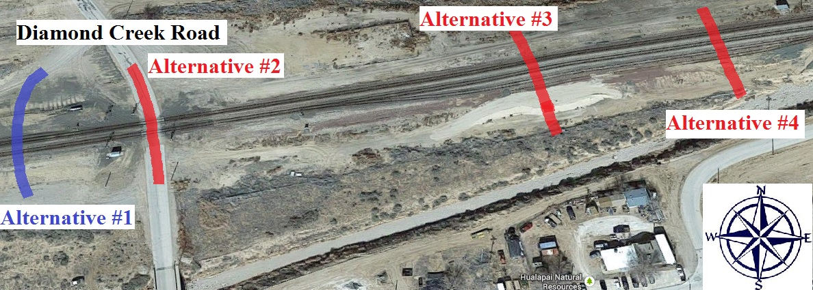
Project Understanding: Four Regions
Four Alignment Alternatives Provided

Slide 7
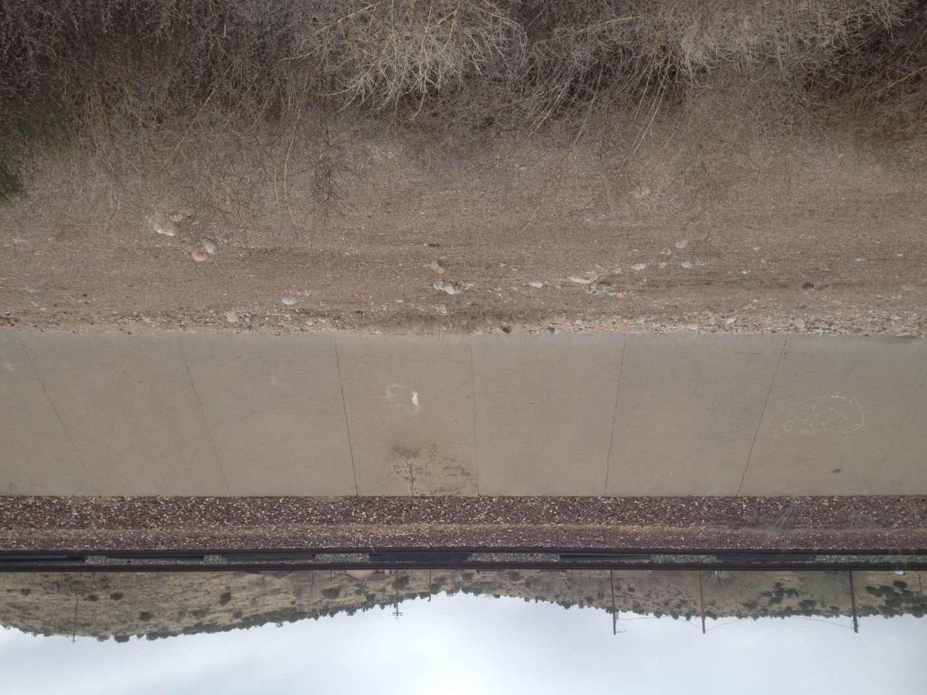
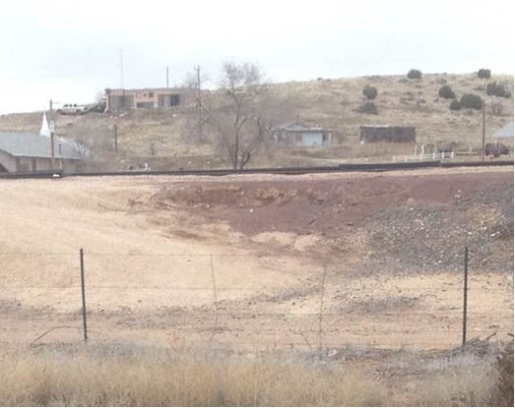
Project Understanding: Challenges
Permissions
BNSF
Landscaping of Region
Channels

Slide 8
Project Scope
Task 1.0 Selecting the Alignment Alternative
1.1 Estimate Cost
1.2 Public Opinion
1.3 Permit Analysis
1.4 Point System
1.5 Final Decision

Slide 9
Project Scope
Task 2.0 Selecting Structure Framework
2.1 Comparison of Various Underpass/Overpass
2.2 Compiling Research
Task 3.0 Super Structure
3.1 Beam Design
3.2 Concrete Design
3.3 Deck Design

Slide 10
Project Scope
Task 4.0 Project Management
4.1 Project Schedule
4.2 50% Design Report
4.3 Final Design Report
4.4 Final Presentation
4.5 Website

Slide 11
Schedule: General Chart
Alignment Alternatives
11 Days
Structure Framework
35 Days
Super Structure
59 Days
17 Days
Project Management
Critical Time (Days)

Slide 12
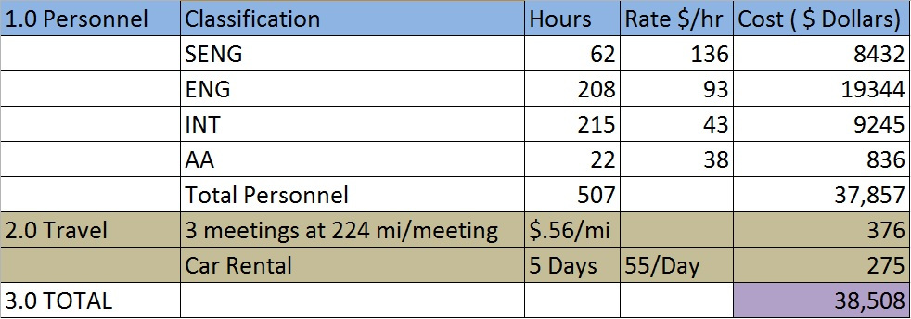
Cost of Project: Final Estimation
12

Slide 13

Questions
13

